Slide 1
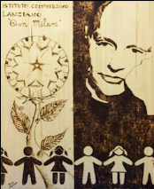

Italian System for bullying prevention

Slide 2
National framework
In the last decade the social and cultural landscape of our country has changed as has happened in many other European countries, resulting in a real educational emergency: bullying.

Slide 3
- Students are unwilling to sacrifice
- they don’t have the necessary autonomy and responsibility
- they are fragile in front of frustrations deriving from failures
- they are disrespectful and sometimes impassive in front of the punitive system put in place by the school

Slide 4

Intervention policies of the Ministry of Education
MIUR

Slide 5
2007
MIUR promoted a specific
National Campaign against bullying activating a mailbox and phone lines to receive reports of cases but also requests for information and advice.

Slide 6
From 2012
MIUR joined the EU's
"Safer Internet”
set up by the
European Parliament and
the Council of Europe
(Decision no. 1351/2008 / EC.)

Slide 7

"Safer Internet”

Slide 8

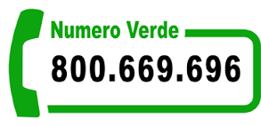
2013
MIUR added virtual places: for students under13 and for over 14 bullismo@istruzione.it www.smontailbullo.it www. webimparoweb.eu www.ilsocial.eu

Slide 9


Slide 10


Slide 11


Slide 12


Slide 13
2015
MIUR published the
"GUIDANCE LINES TO PREVENT BULLYING AND CYBERBULLYING“
an important benchmark for teachers and households.

Slide 14

Local Framework
Regional Observatory
reference point for teachers, schools and public bodies.
Local Support Centres (CTS)
Lanciano houses the local CTS point:
It acts in favor of pupils with Special Educational Needs,
It promotes learning, development and socialization of students with disabilities and specific learning disorders,
It provides information, advice, training, for children with learning difficulties,
It founded a Help desk against Bullying and Cyberbullying

Slide 15

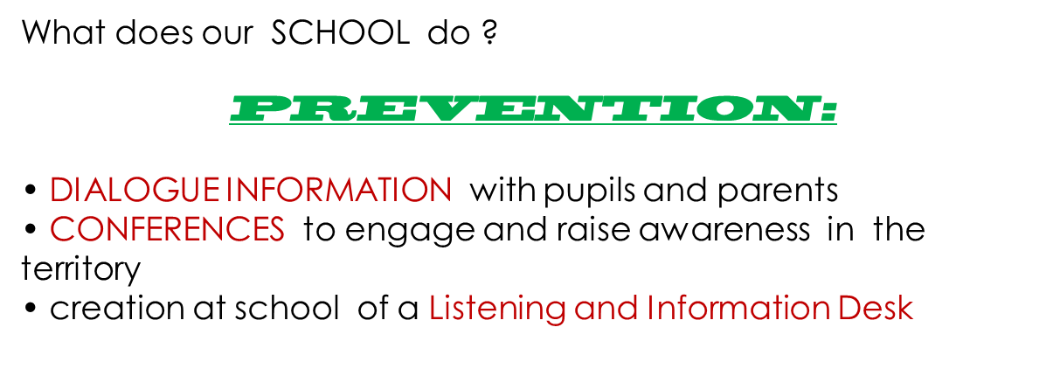

Slide 16
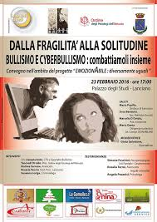
Conferences at Don Milani

Slide 17
Listening and Information Desk
It involves:
the Department for Social Policies of
Lanciano Municipality;
Psychologists;
Sociologists;
Pedagogists
for Infant , Primary and Secondary school;
Lawyer

Slide 18
Our Listening and Information Desk:
• Provides opportunities to exchange ideas on the issue of legality;
• Supports the rights of children
• Provides information about criminal liability of minors;
• Enables discussions on risk behavior;
• Supports self-confidence in victims of bullying;
• Promotes exchanges between schools, local authorities and parents to encourage alliances and synergies.

Slide 19
Actions carried out in the last two years
film club for students with the support of an experienced lawyer in juvenile law, an educational psychologist and a psychologist.

Slide 20
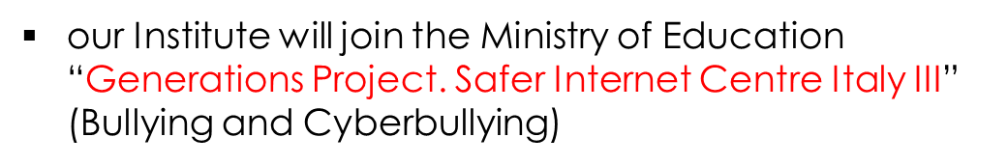



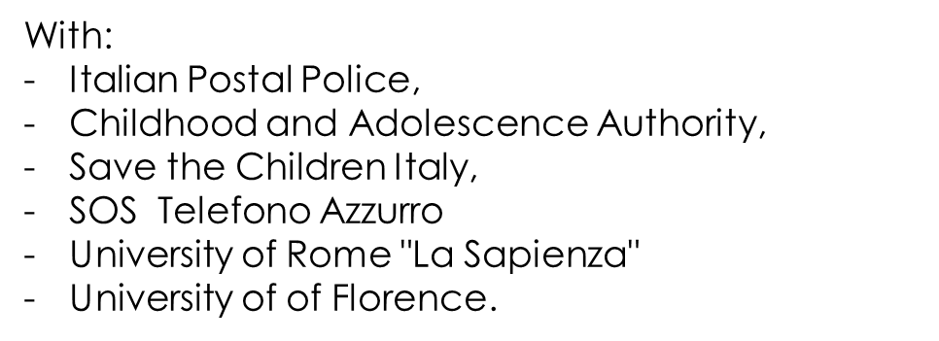



Slide 21
CURRENT STEPS AGAINST BULLYING
Due to the systematic work
of prevention operated from our area,
our School is characterized by
the absence of critical situations regarding bullying.
We just detect
events of minor importance
which are not, in any case,
neglected !

Slide 22
ONCE a single episode is detected , the school:
• Activates an educational and
non-punitive approach;
Promotes Dialogue: teachers first talk individually with the students involved;

Slide 23
• Works on victims or bullies
through individual support,
according to a moral approach
(right and wrong),
legal approach
(to live inside-outside the rules)
and humanistic approach
(understanding rather than punishing);

Slide 24
• Works with the group class
enhancing social skills,
promoting cooperation and solidarity,
mediating conflicts among peers
thanks to our School Project “EMOZIONABILE”
(readings, videos, films, guided class discussions, questionnaires, meetings with external experts)

Slide 25


Slide 26
The teacher's role in the fight against bullying

Slide 27
Being trained / informed on the phenomenon, stop it immediately and further be able to develop programs or intervention techniques
• Do not ignore or underestimate what the students say

Slide 28
• Emphasize what happens immediately, not letting go
• Take advantage of the power of the bully in a positive way

Slide 29
• Develop important activities on the theme of bullying (discussions, role playing, lectures)
• Develop a positive atmosphere in school

Slide 30
• Protect the victim, do not ask him/her to explain what happened to in front of others, but in a private dialogue to try to free him by feelings of guilt and give emotional support.

Slide 31
…thanks for your attention!

