Slide 1
I stop bullying with art and sport
Spain 16-22 june 2019
…..New friendships,cultures and countries!
Erasmus+

Slide 2
The departure and the arrival
Lanciano: 1: 05 o'clock!
Rome airport: 5:00 o’clock…..here we wait 3 hours and half!
9.30 o’clock: we are on the plane and we are afraid of taking off!
We arrive in Madrid: 12.00 o’clock and we catch the bus to La Solana
La Solana: 14.30 ….. I met Juan Fran, he hostes me.

Slide 3
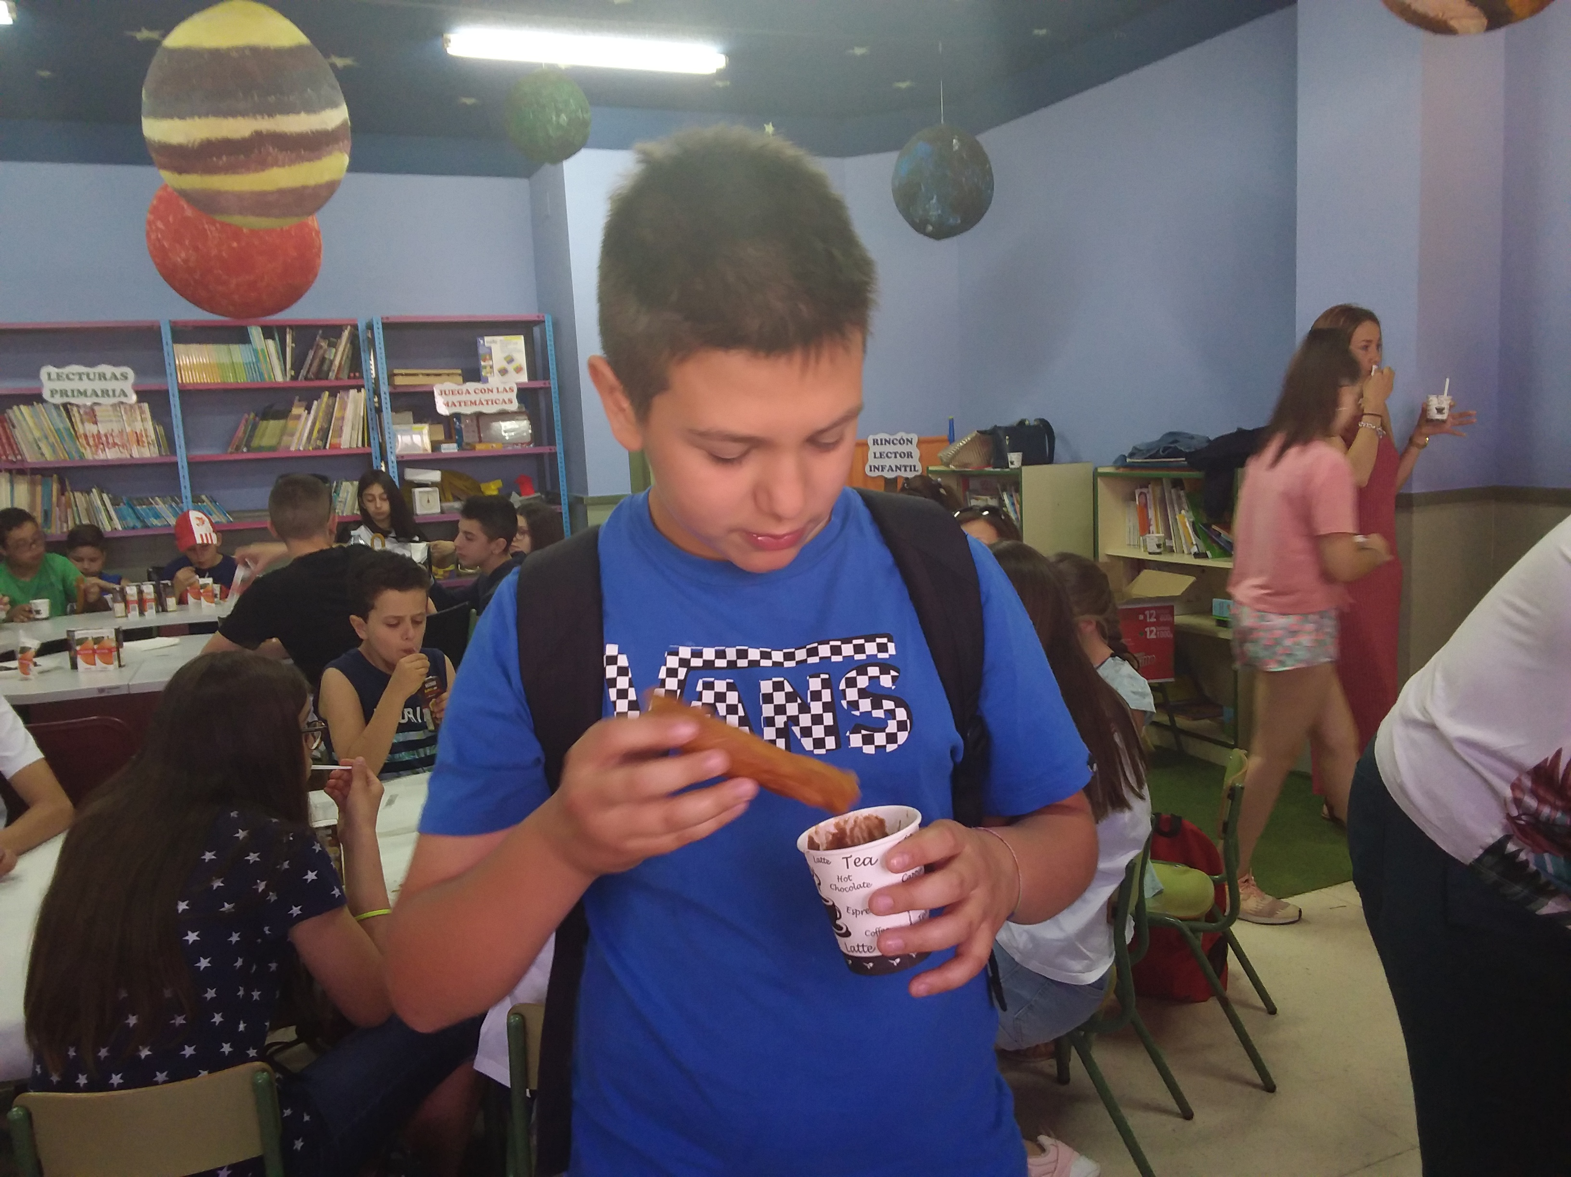
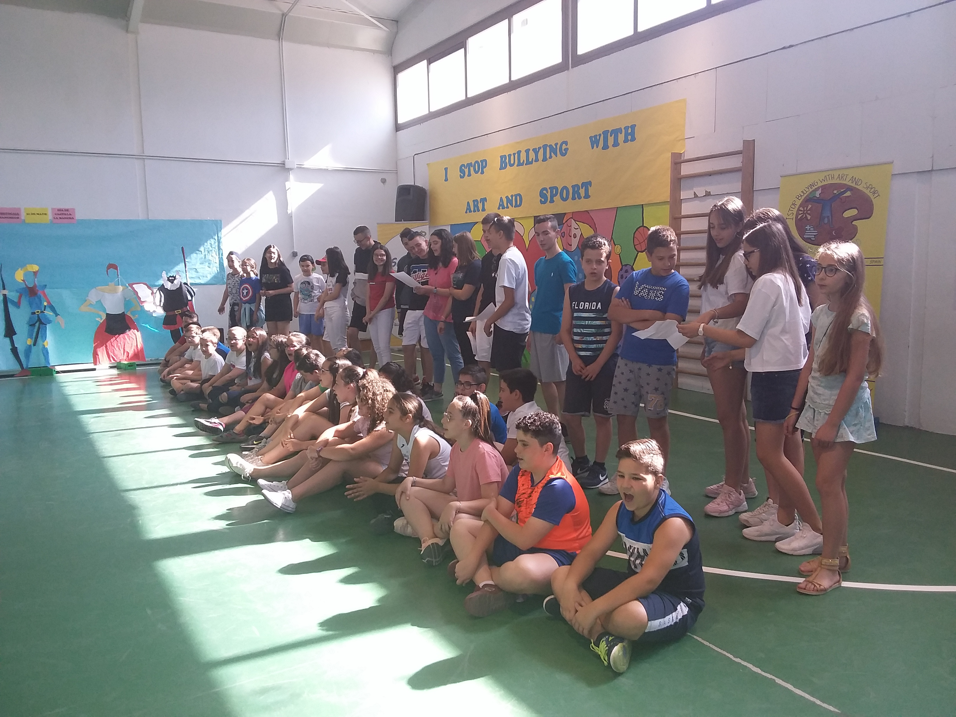
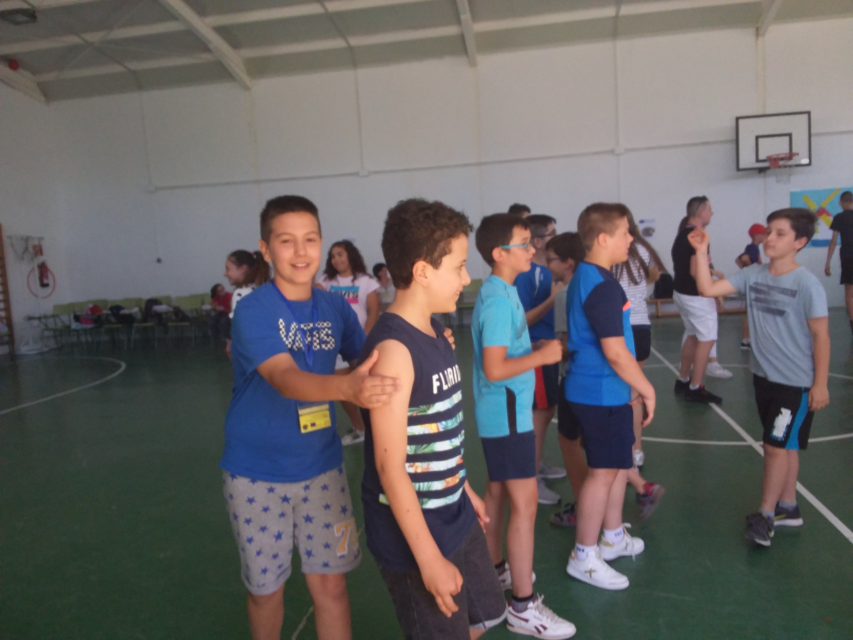
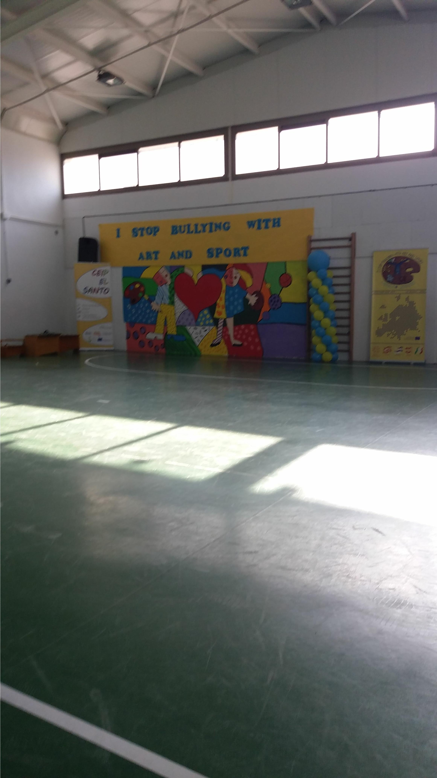
On moday: the school in La Solana and activities for the Erasmus Project

Slide 4
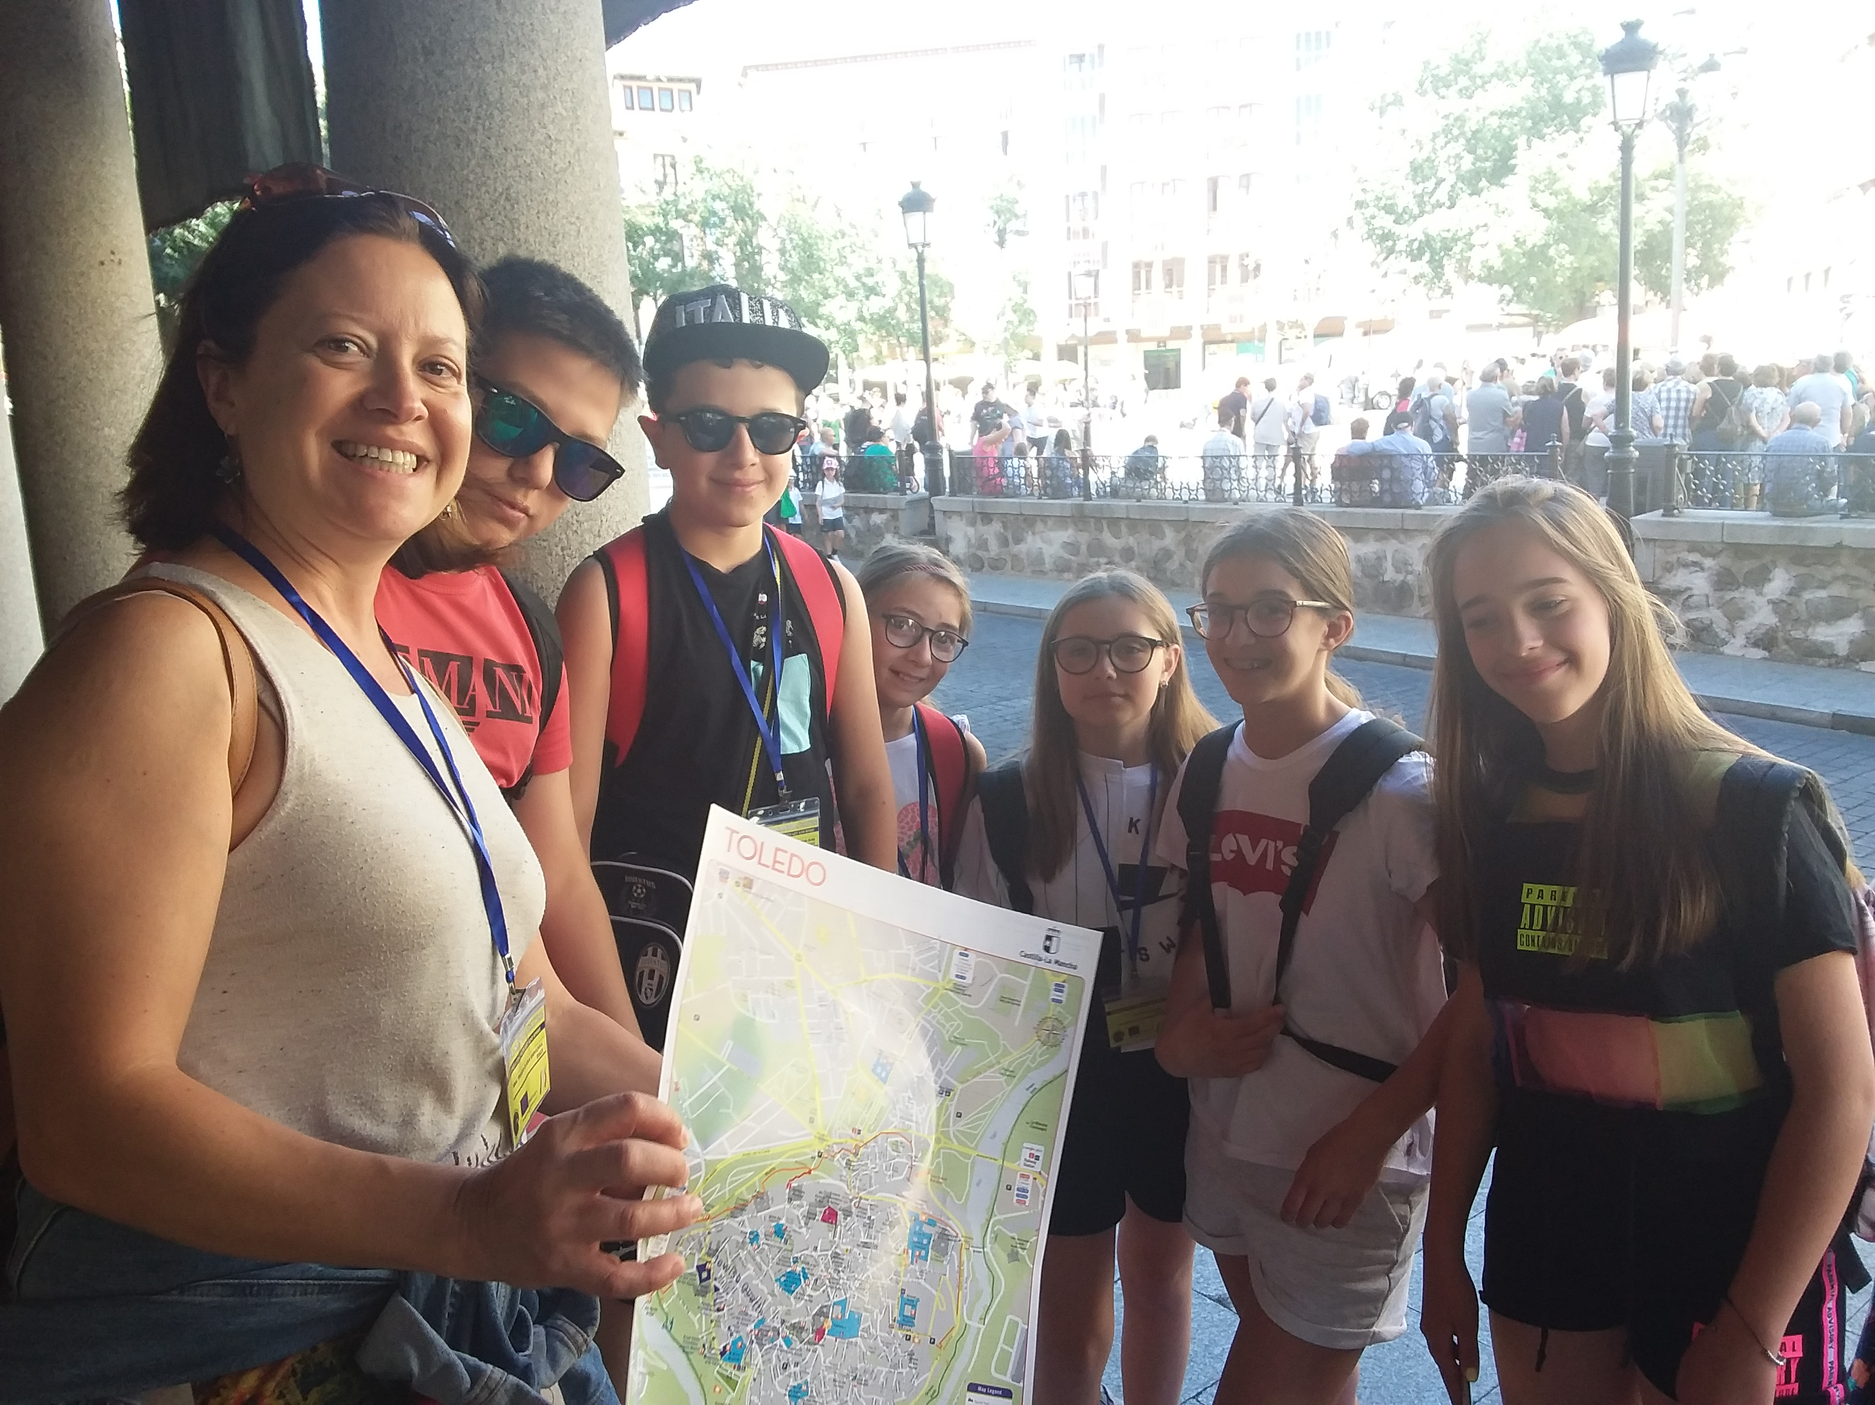
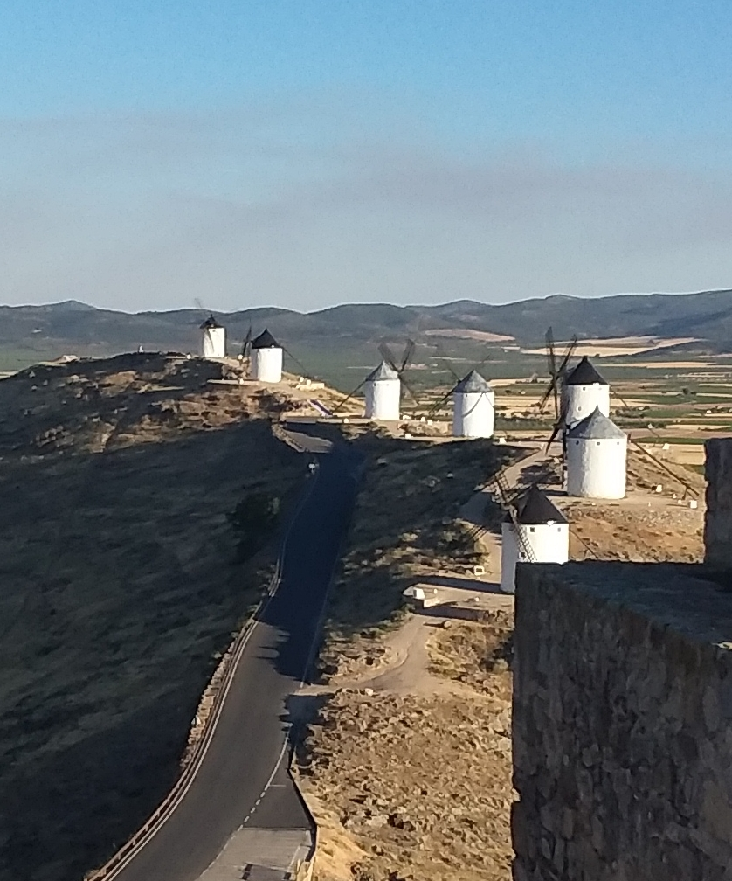
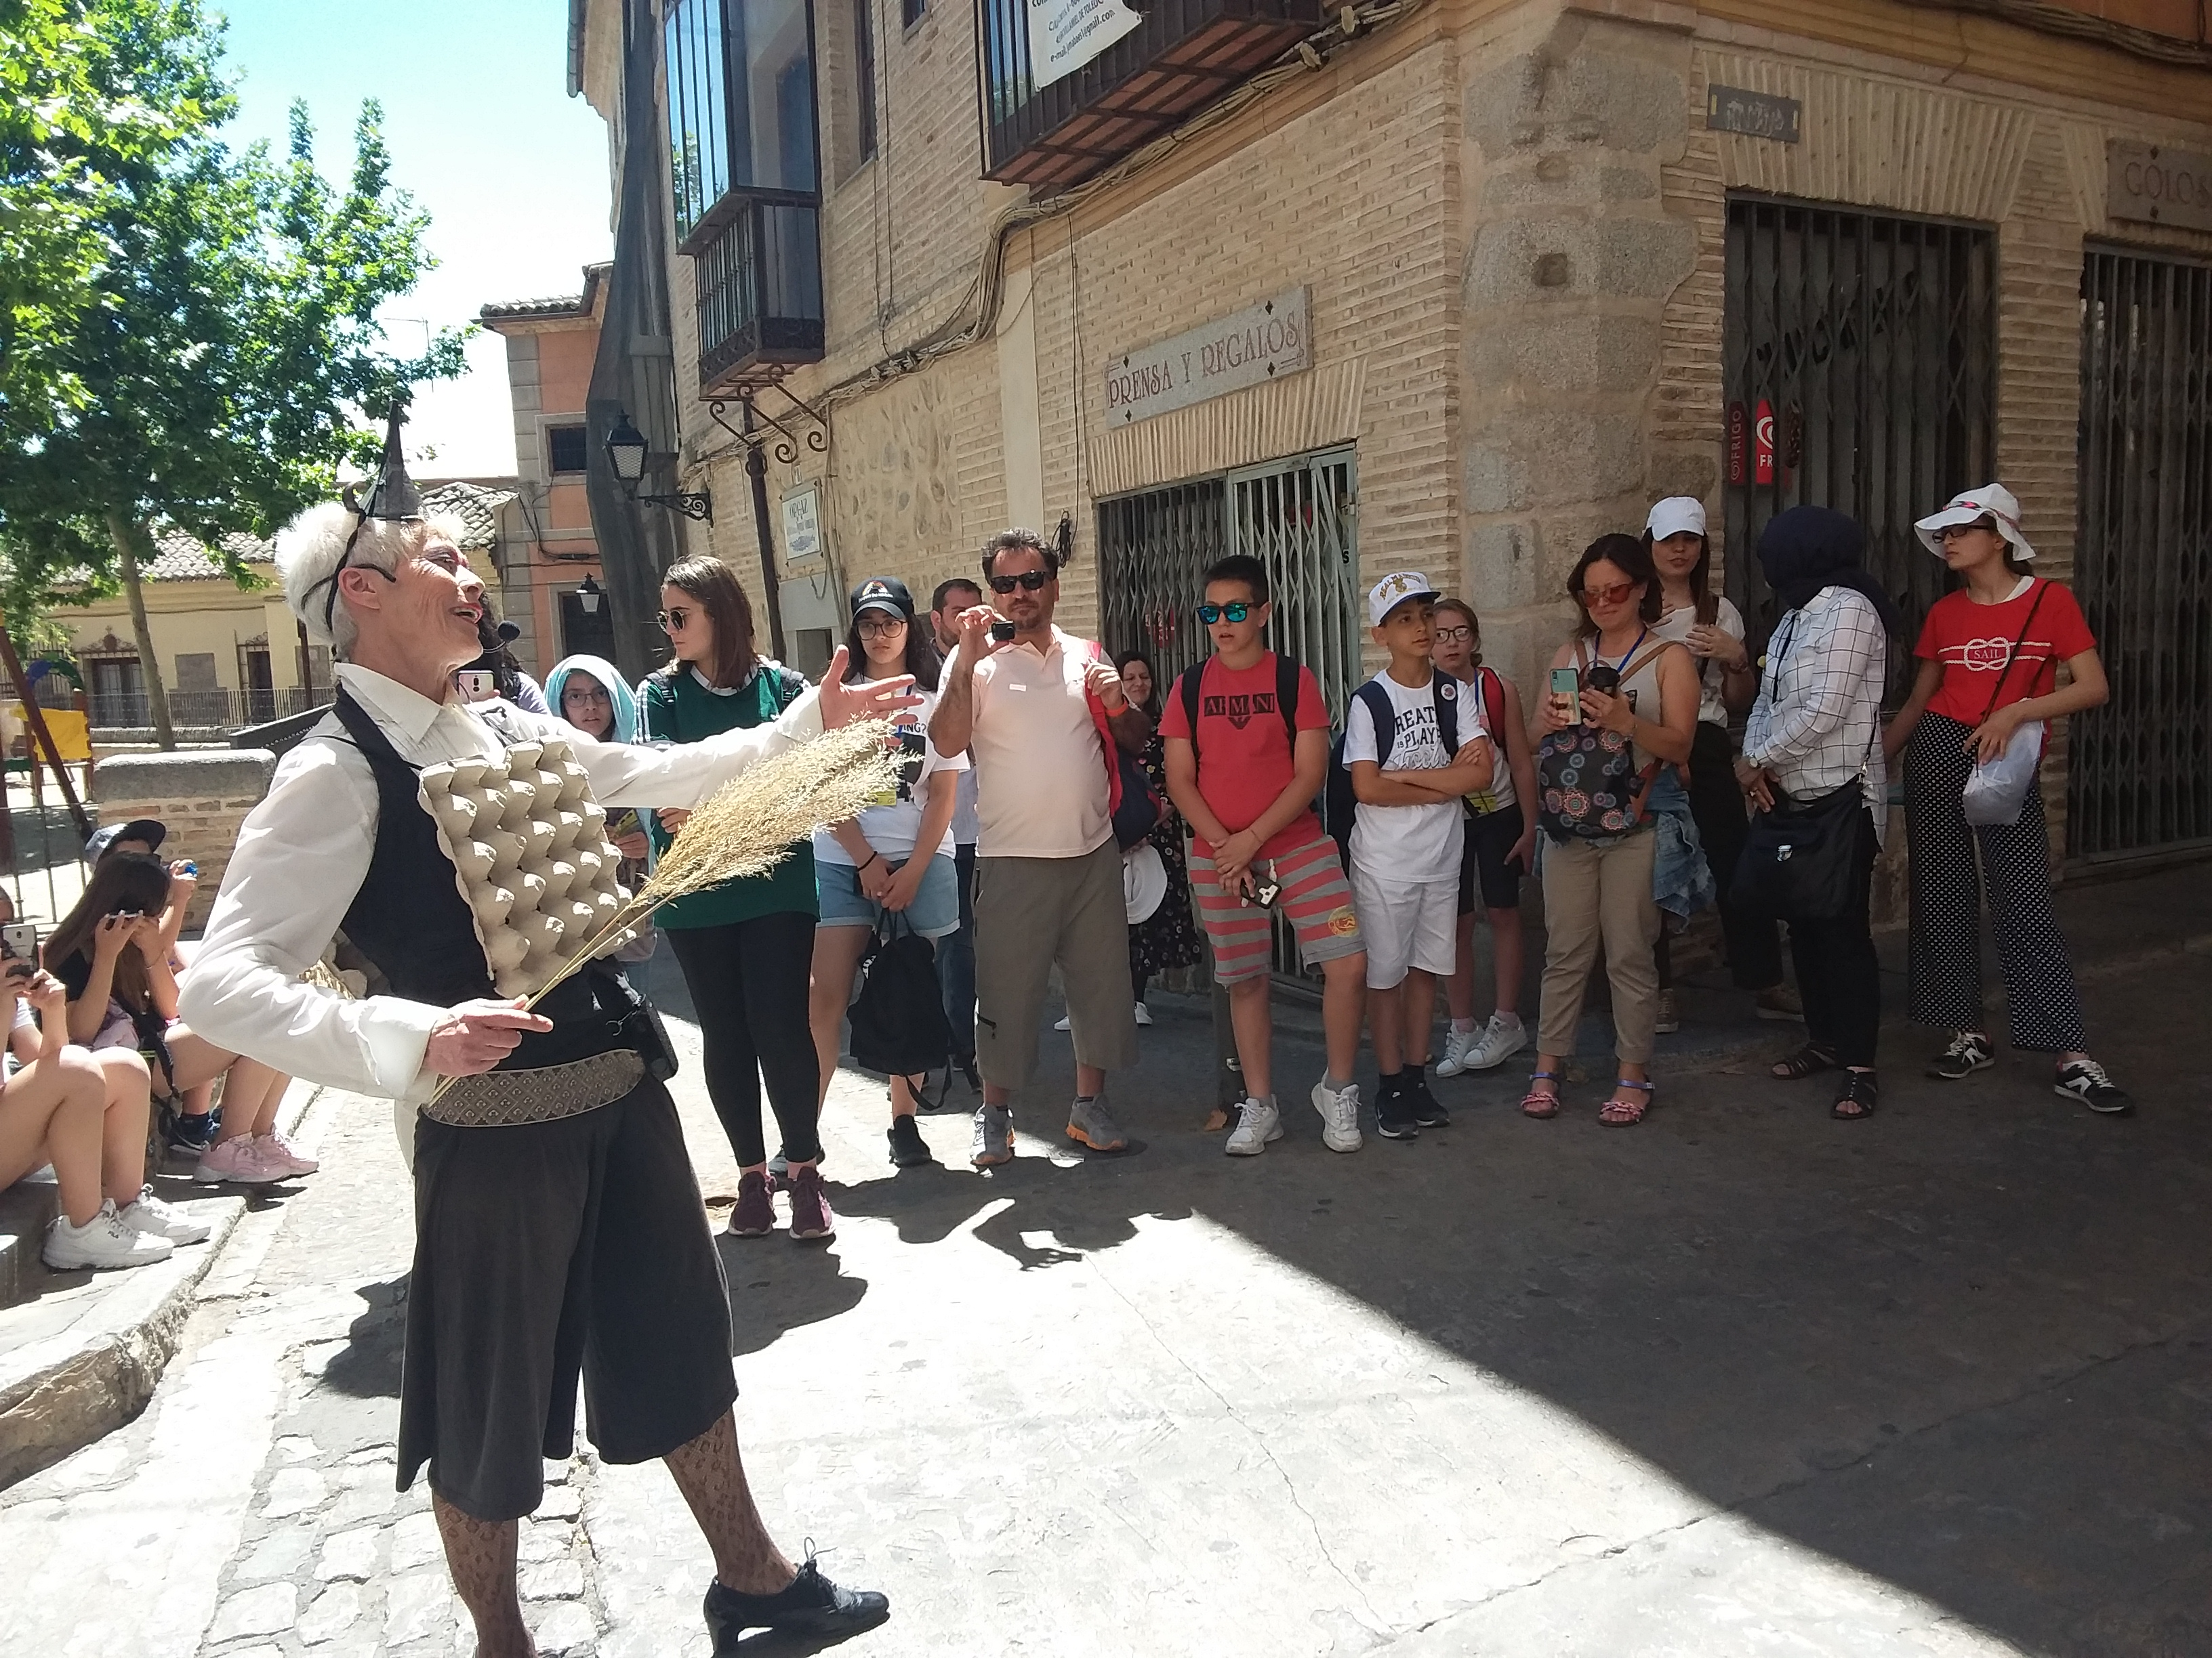
Toledo
We visit the city with a guide who explains us the important places of Toledo.
We also visit the Don Chishotte’s route

Slide 5
PresentationS of our project works
Sofia and Salvatore present the power point “ The Italian Painters”
Ludovica and Gabriela present the ancient game “Zompa Cavallo”
Caterina and Juri present the elastic game and the handkerchief game.

Slide 6
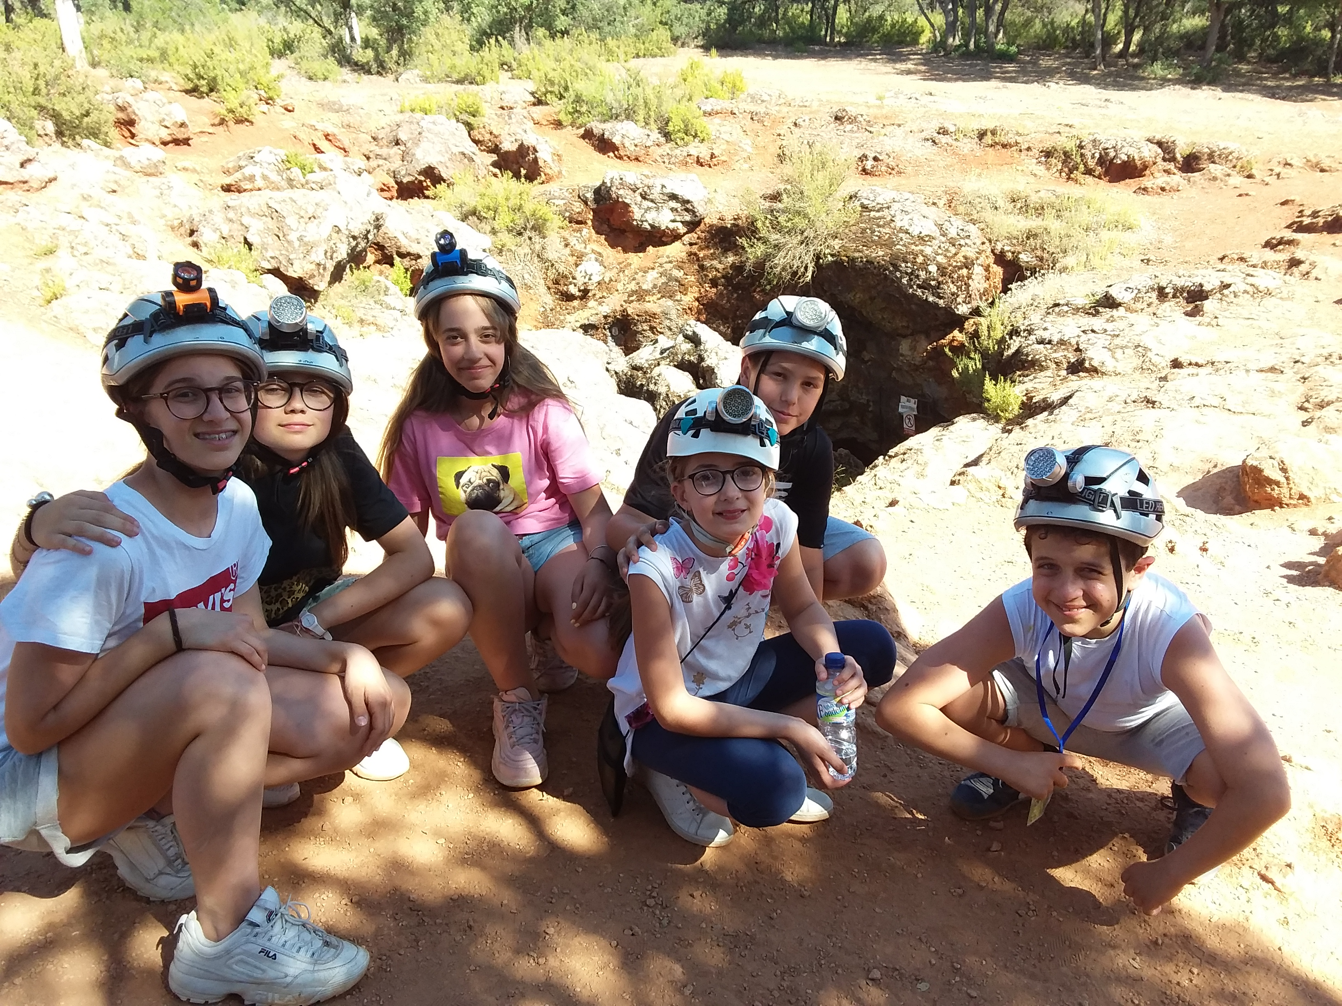
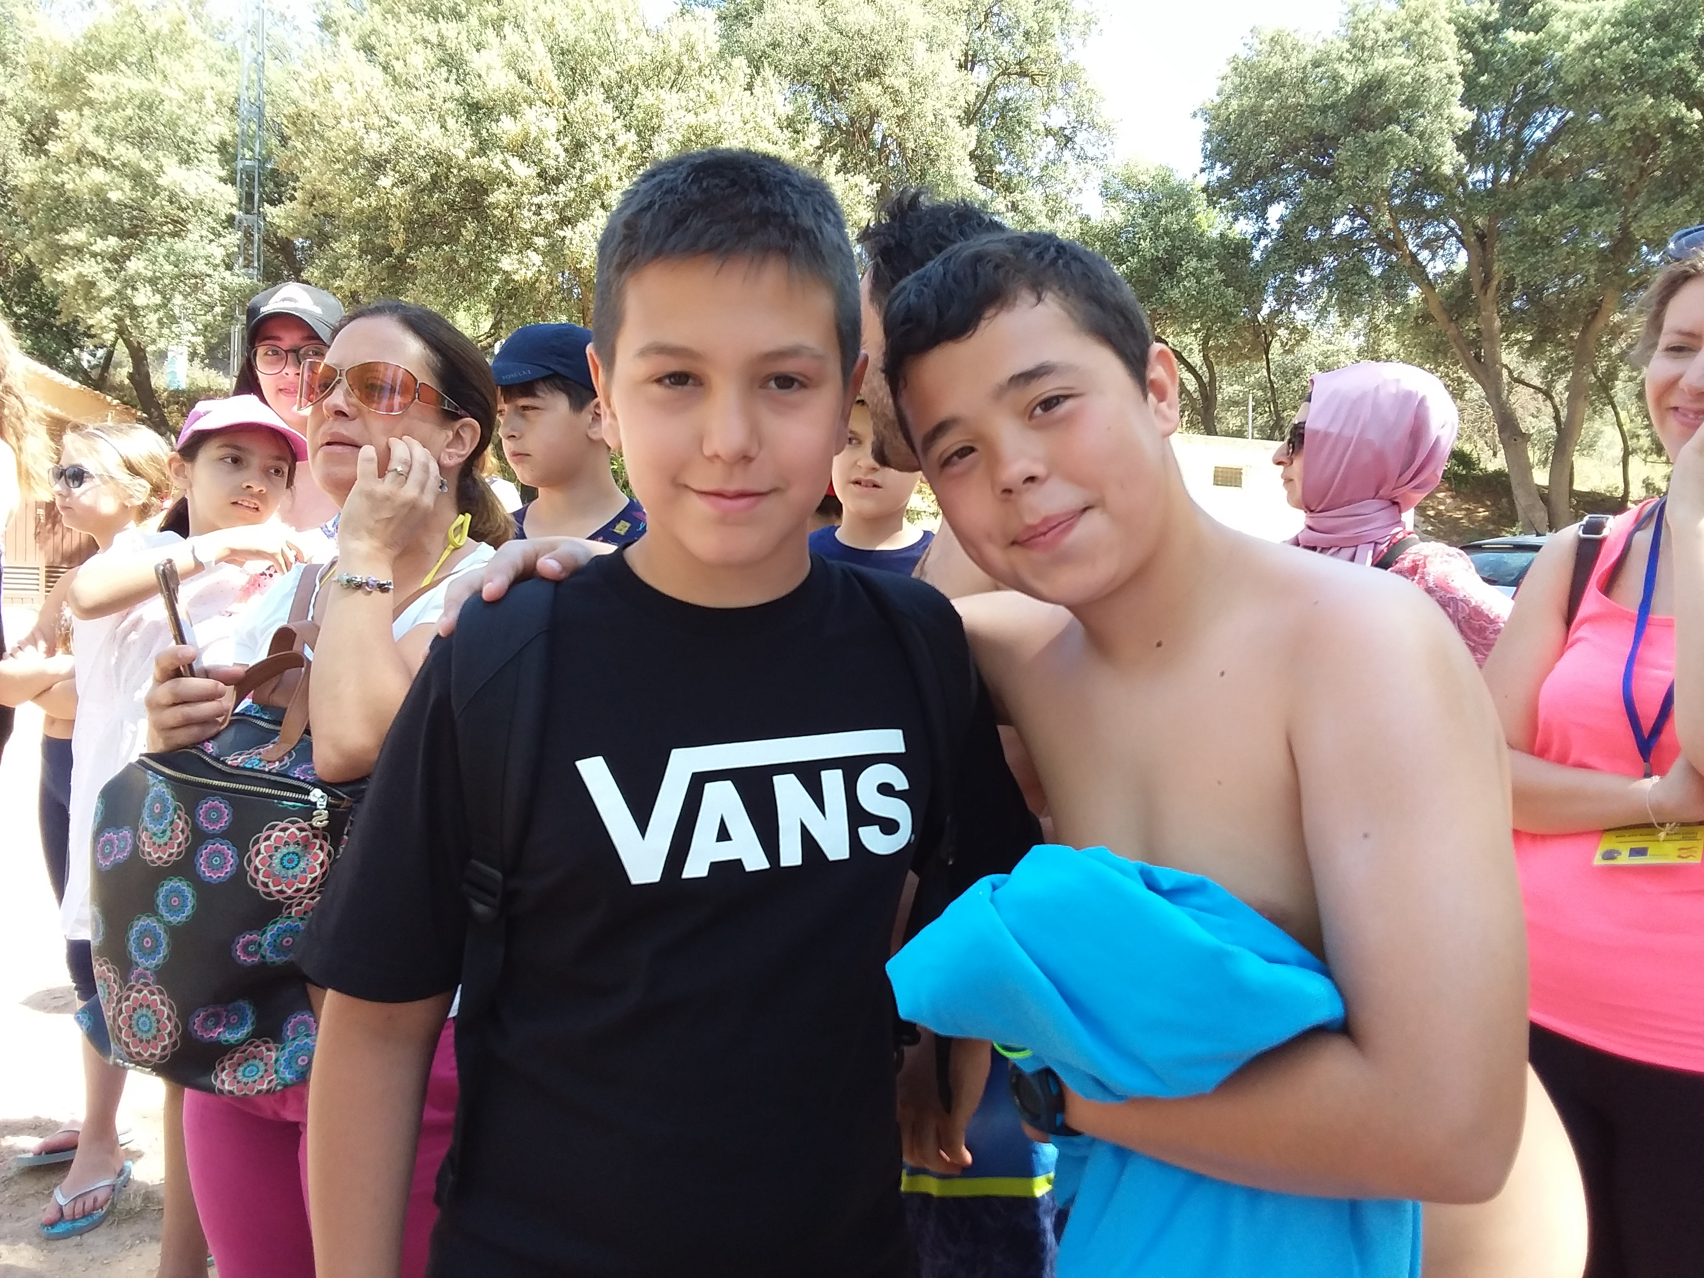
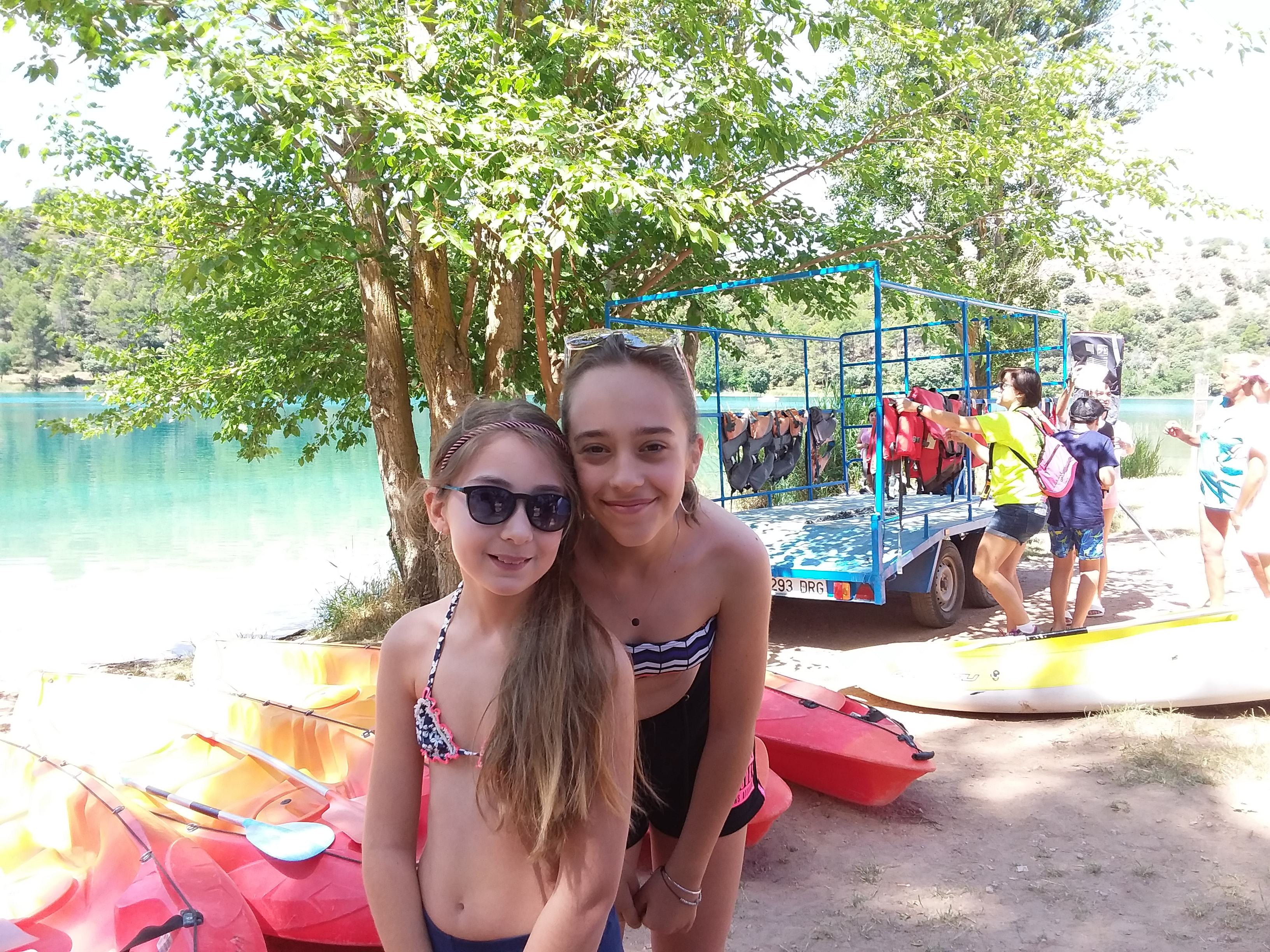
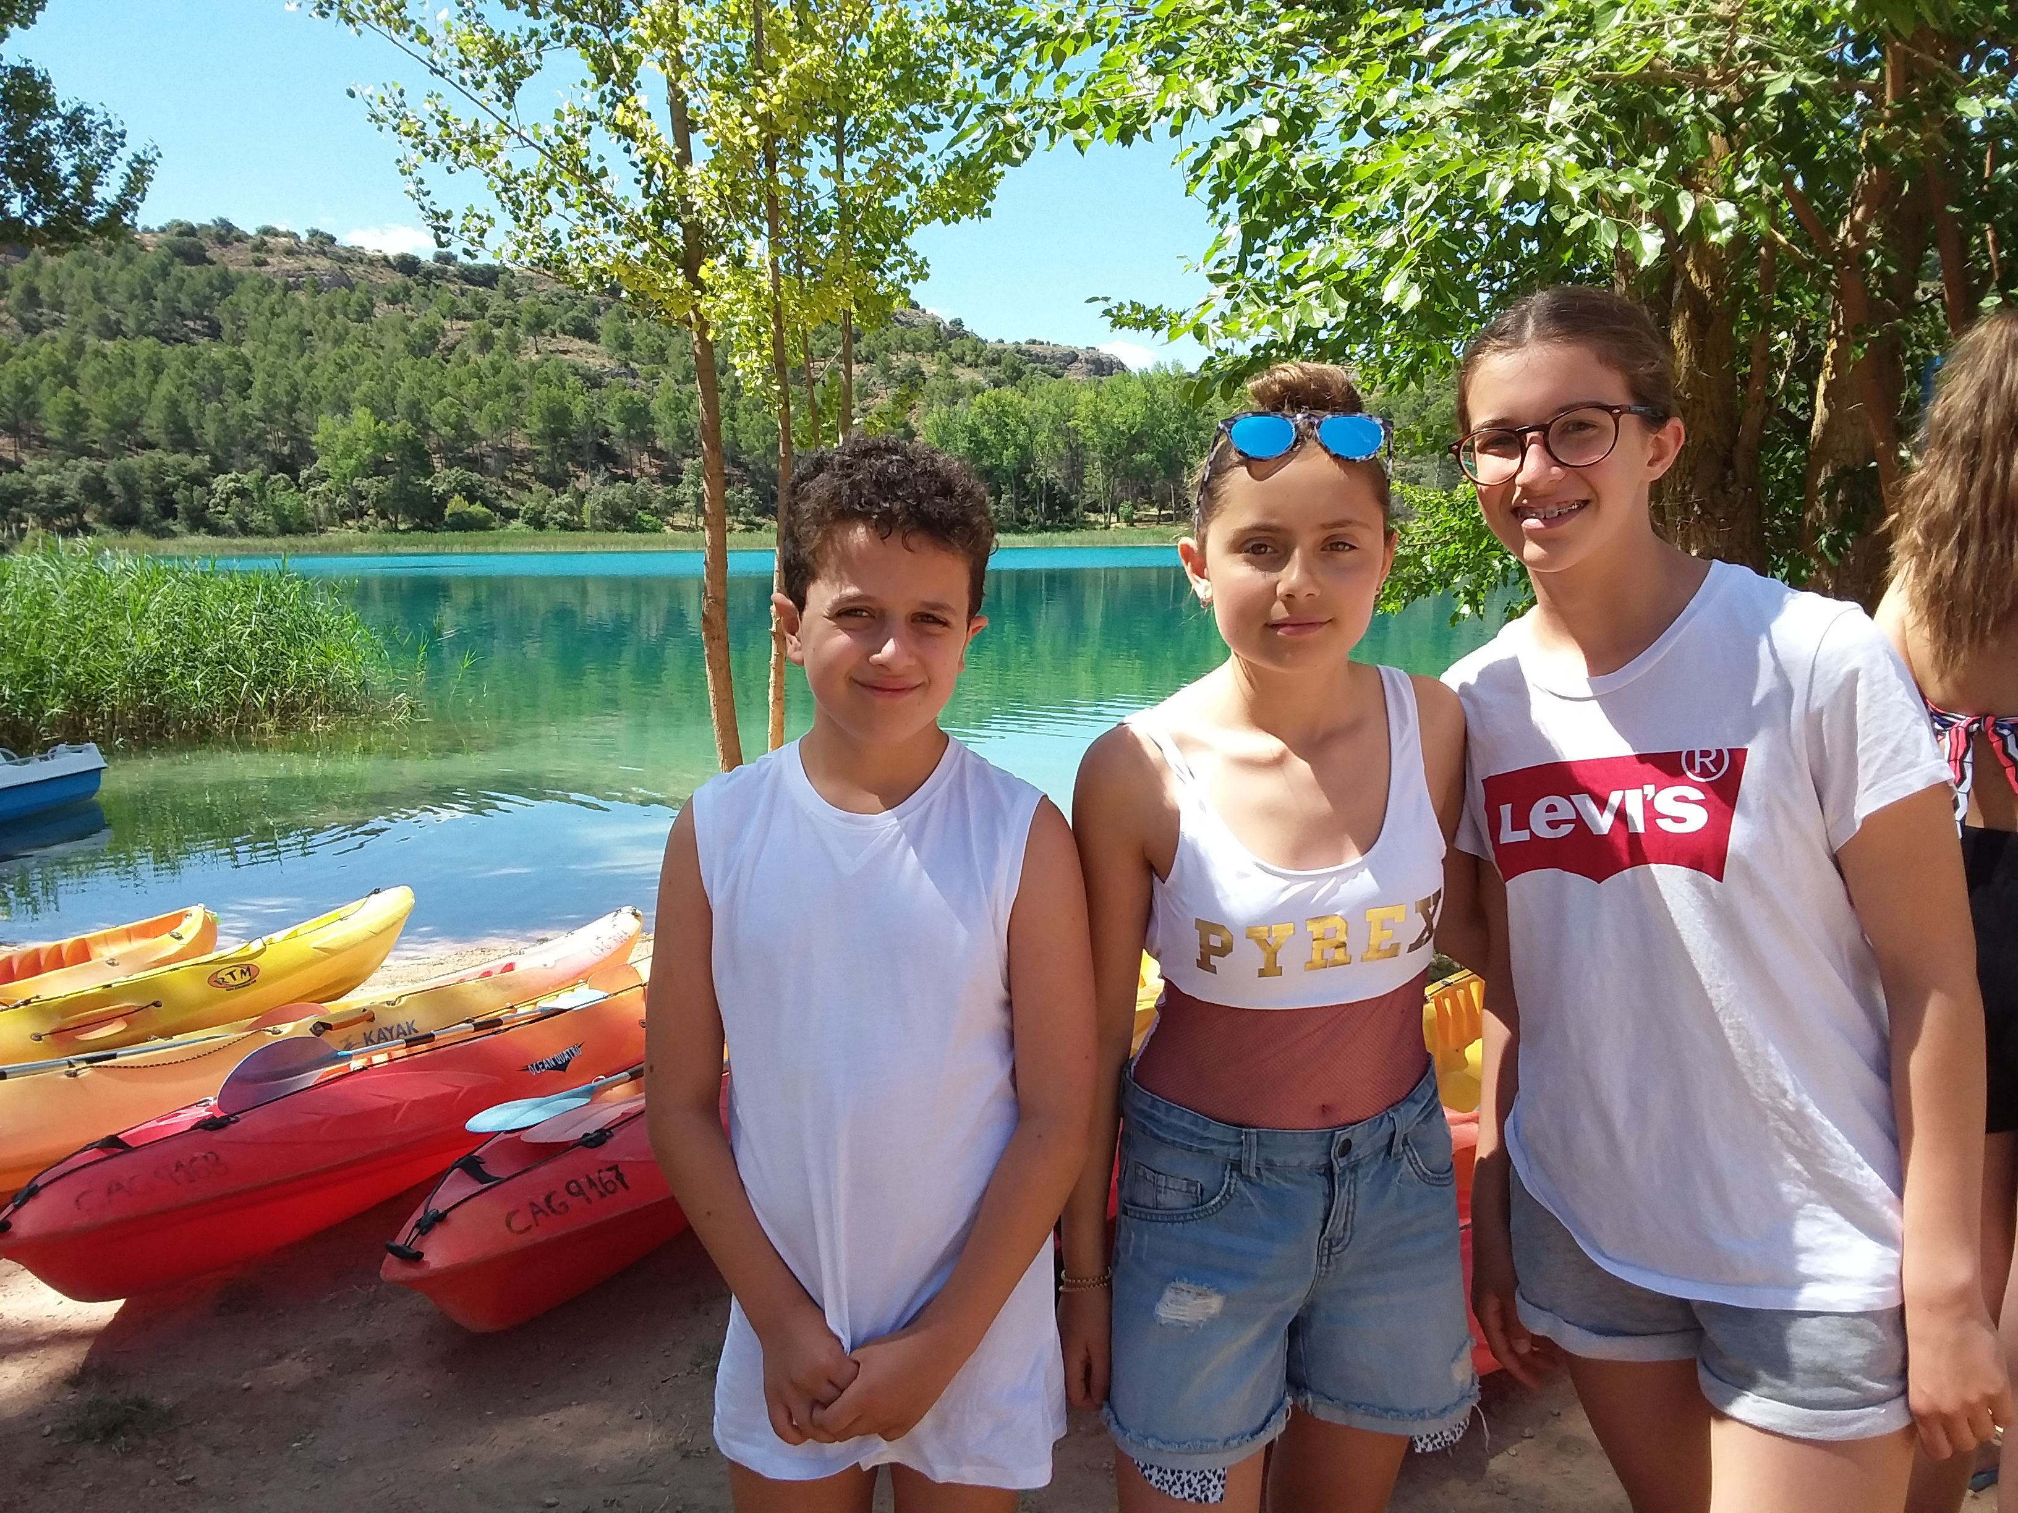
Ruidera and the Sports Activities
We practice different sports (archery, kayaking and climbing) and we visit a cave

Slide 7
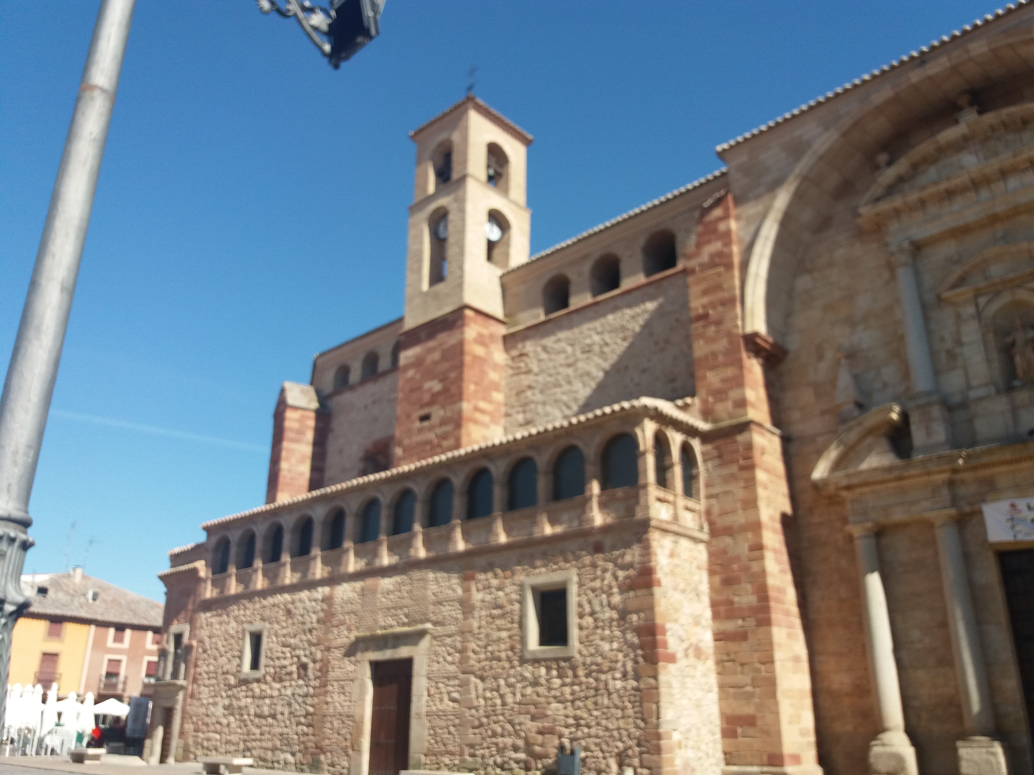
Visit La SolanA
We visit the cathedral, the museum where inside there are ancient objects like old benches, old plows etc ... and then the oldest small church in the city

Slide 8
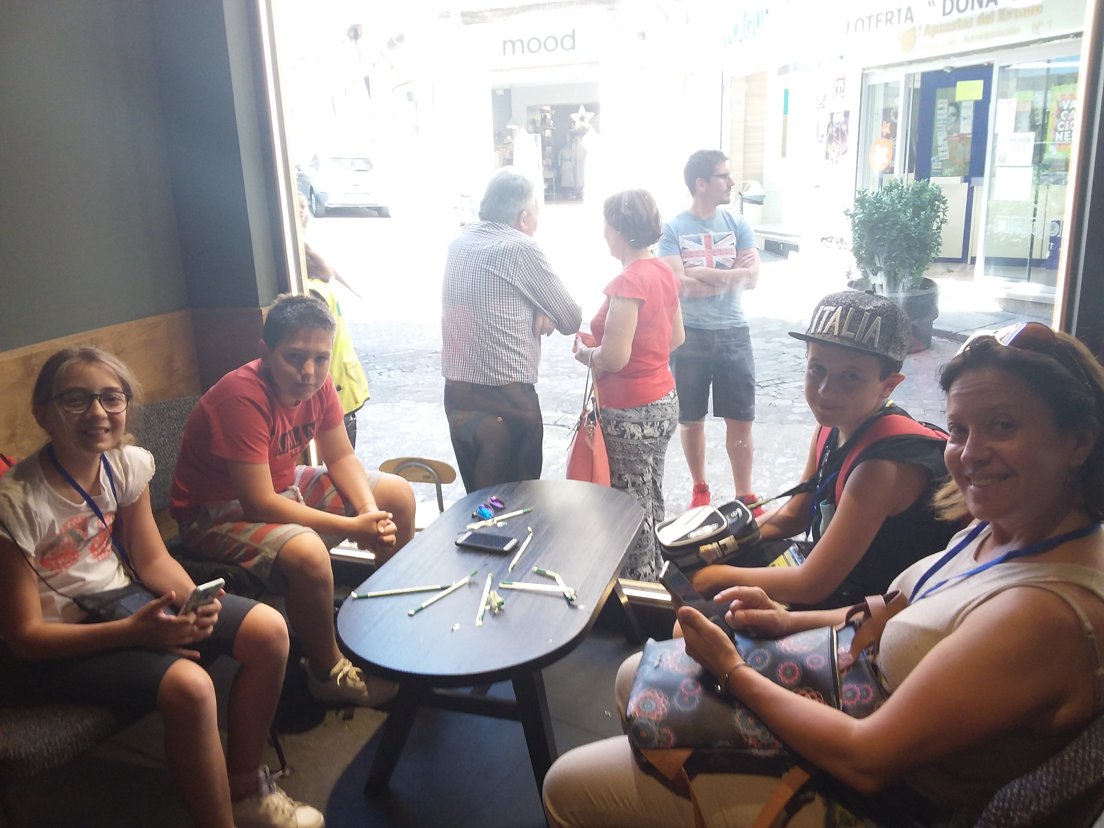
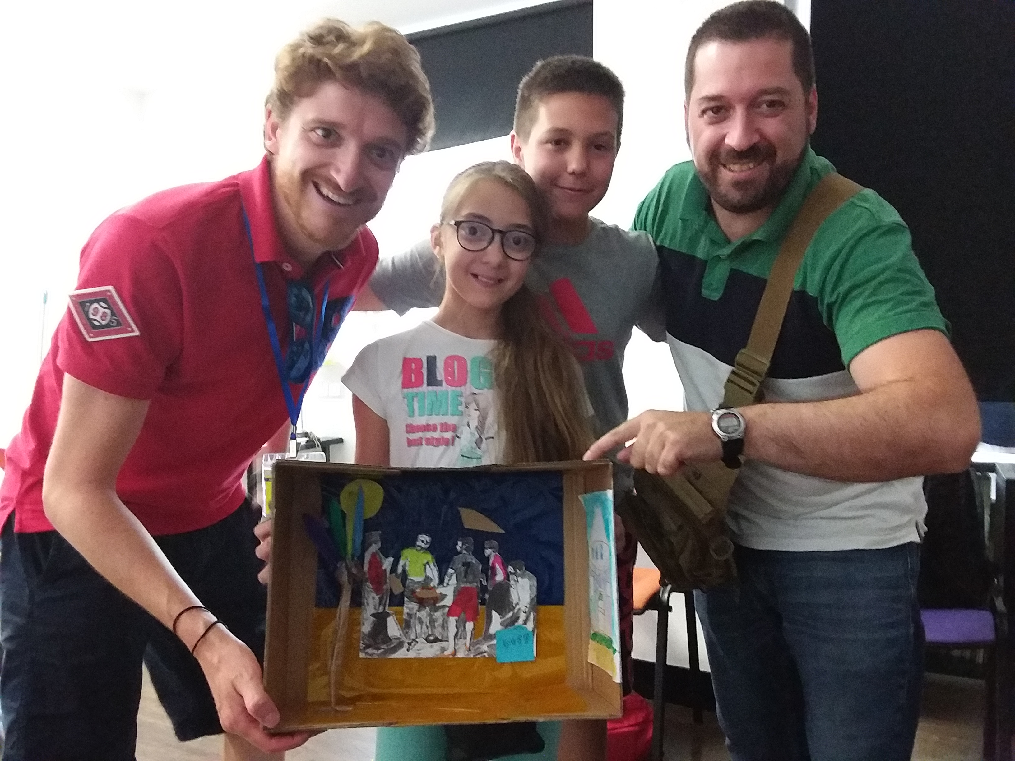
Madrid
Prado museum: the most famous Spanish paintings and painters
Arstic Workshop and finally free time for shopping!!!

Slide 9
The end
Salvatore D’Urso I B don Milani School Lanciano Italy

